Slide 1
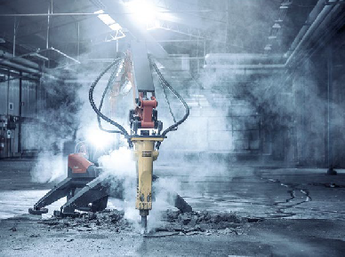
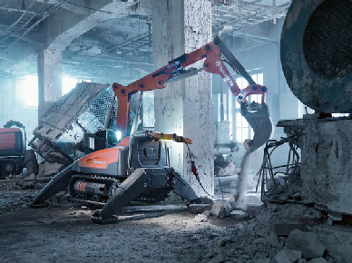
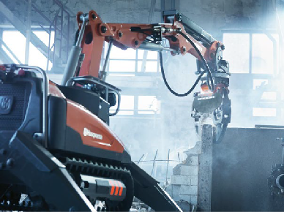
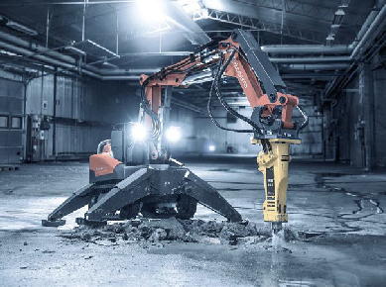
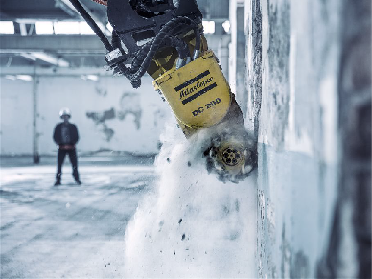
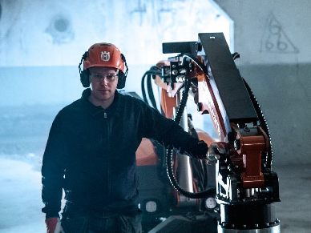
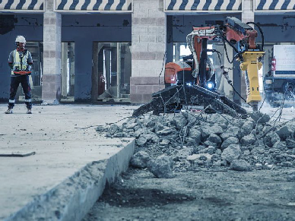
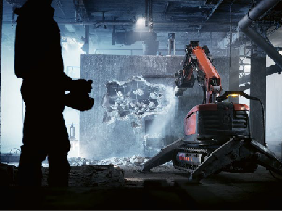
New DXR Product Range Presentation

Slide 2
The targeted customer personas
Demolition contractors 60%
Sawing and drilling contractors 30%
Contractors value sturdy and reliable machines with high uptime and productivity. Low cost of ownership, efficiency and ease of use. Good relationship and support from sales.
Rental companies 10%
Rental companies values low cost of ownership, sturdy machines with high durability and low service needs.
Customer challenges
Downtime if machines breaks or needs service often. Difficulties reaching areas for demolition work.
Need of precise demolition or demolition in sensitive or hazardous areas.
4

Slide 3
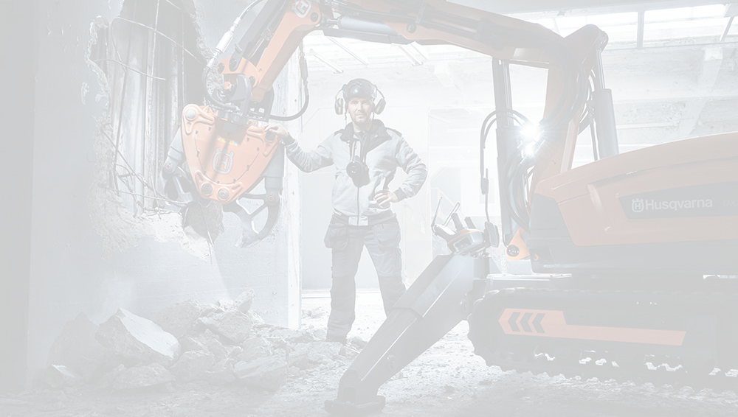
DXR Range
What user benefits does it provide?
Increased power and productivity
What are the key features that provide these benefits?
Electrical power has increased more than 20% on all 4 models. Hydraulic flow has increased by 10% on DXR 275, 305 and 315. Optimized power in all conditions.
Live data via the remote control – current, voltage, temperature, active faults and operating time. 300 m reach in distance. Diagnostics of the remote control
Joystick thumb switches, quick-switch
work/ transportation mode, one-hand transport mode, multiple operator patterns.
Excellent power-to-weight ratio, good balance and stability, full control of arm and outrigger cylinders, easily adjustable hydraulic parameters
Control of your operation
Precision and efficiency
Smooth operation

Slide 4
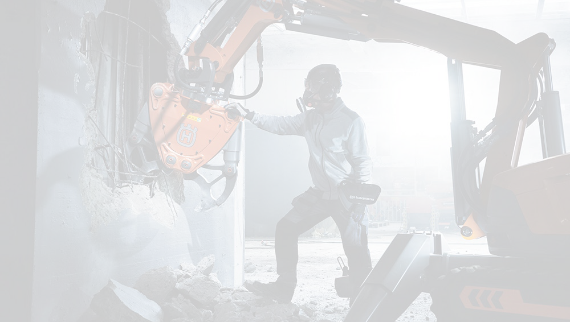
DXR Range
What user benefits does it provide?
Enhanced operator safety
What are the key features that provide these benefits?
Machines are third party certified regarding machine safety, EMC and functional safety. Long-distance remote connection up to 300 m.
High-end large LCD screen with optimized viewing angle. Adaptable to dark and bright surroundings. Harness or belt for an even more pleasant workday.
Easy access to service points, hydraulic track tension, service and error notifications
Ergonomic and user-friendly
Easy maintenance

Slide 5
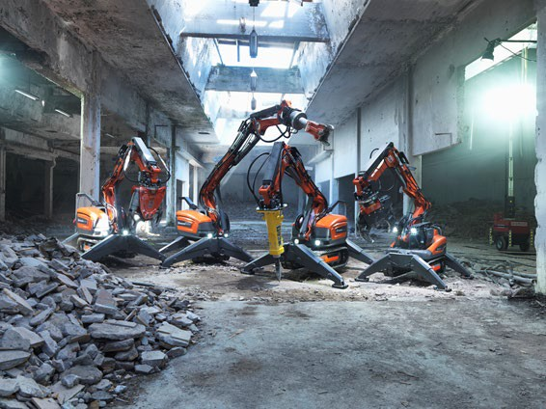
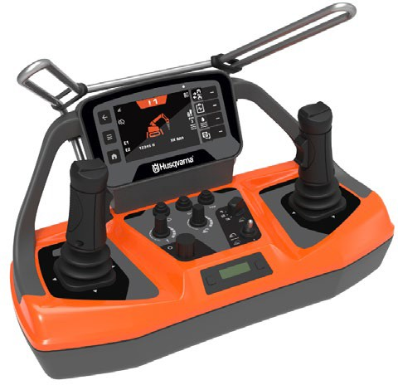
Story behind – why we have developed a new DXR range
To increase power and efficiency for even further improved productivity.
To fulfill third party certification around standards related to Machine Safety, "Functional Safety" and EMC.
Improve the user experience with an all- new remote control

Slide 6
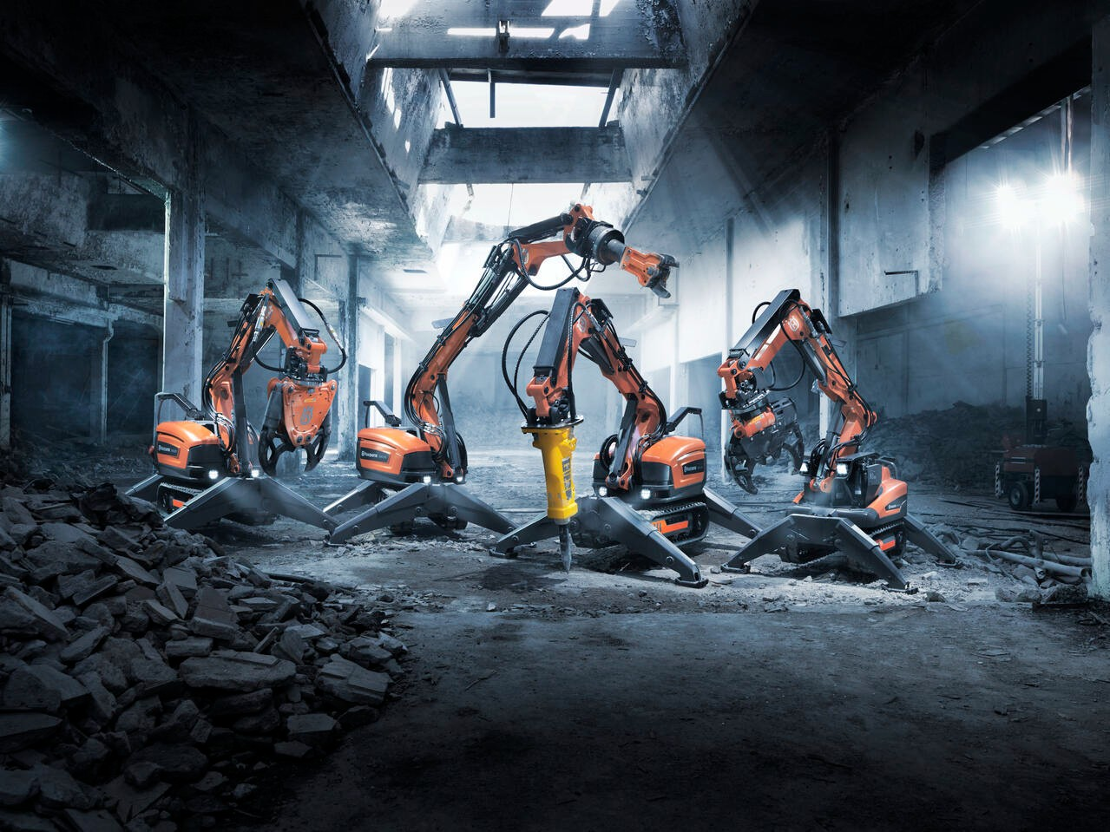
Range overview
DXR 145
DXR 275
DXR 305
DXR 315

Slide 7
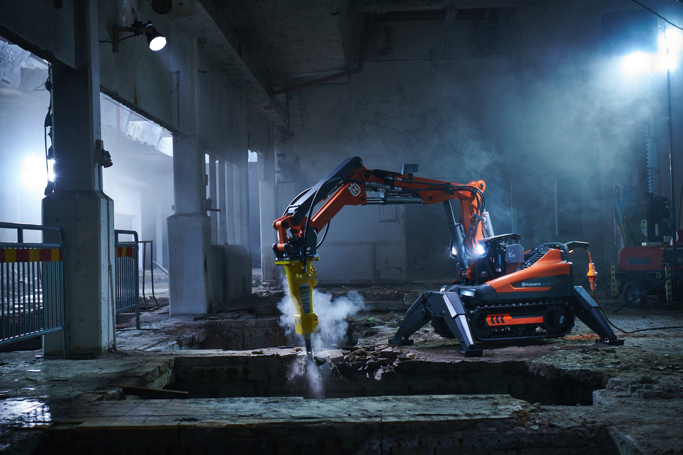
DXR 145 in short
DXR 145 is developed for the customer in need of a compact powerful Demolition Robot in the 1-ton segment. It offers great power to weight ratio and is easily transported in a normal van. The all-new control system and remote control provides a new level of control and user experience.

Slide 8
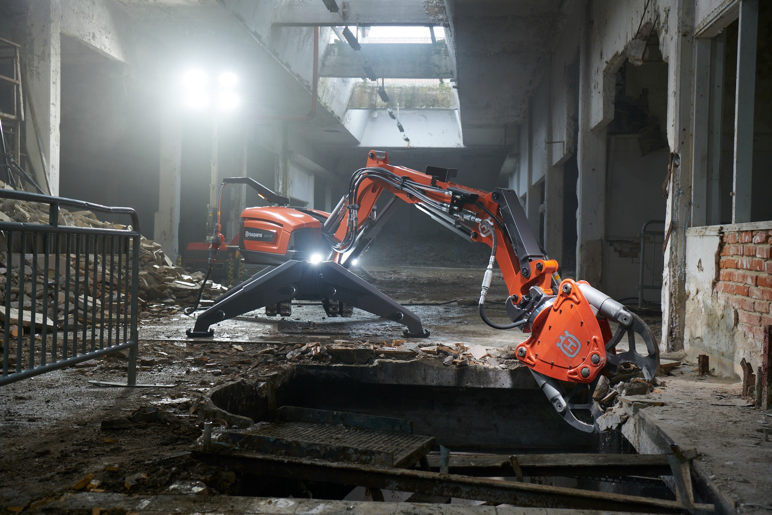
DXR 275 in short
DXR 275 is developed for the customer in need of a demolition robot with a high power to weight ratio while providing low ground pressure.
Performance is increased even further over its predecessor.
The all-new control system and remote control provides a new level of control and user experience.

Slide 9
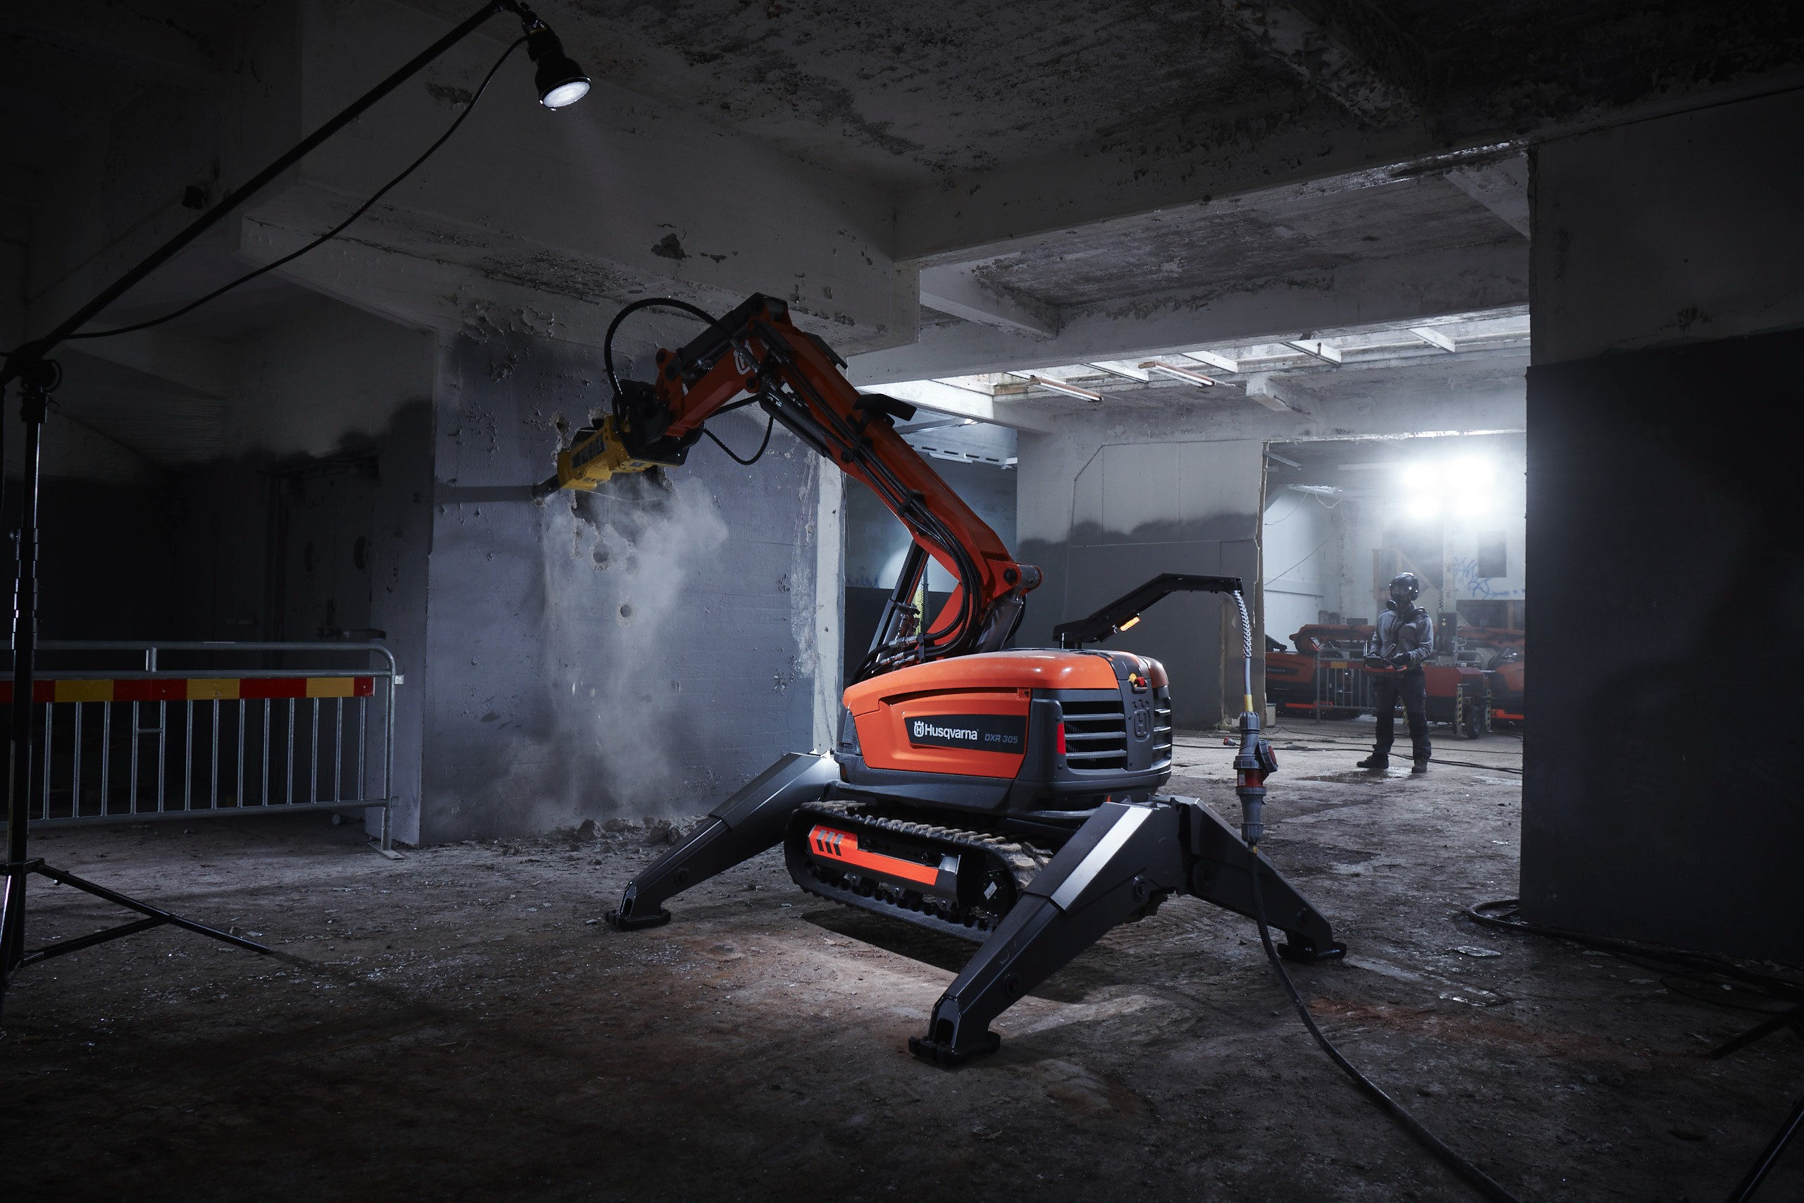
DXR 305 in short
DXR 305 is developed for the demanding customer in need of a Demolition Robot in the 2-ton segment with maximized performance. Performance is increased even further over its predecessor and is now provides 85 lpm of hydraulic power. The new control system and remote control provides a new level of control and user experience.

Slide 10
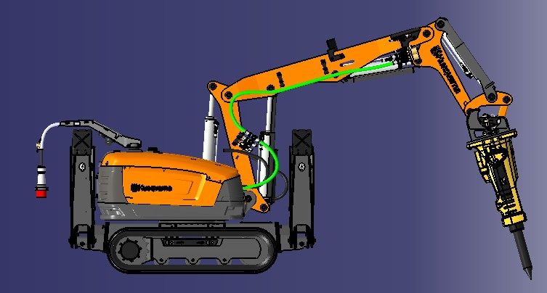
DXR 305 – New unique breaker return line
Separate return hose for the SB302 breaker, connected directly to the hydraulic tank
→ Improved efficiency
→ Higher impact force
→ Higher hitting frequency

Slide 11
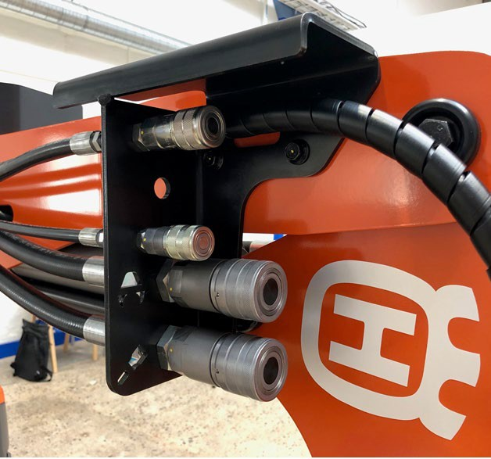
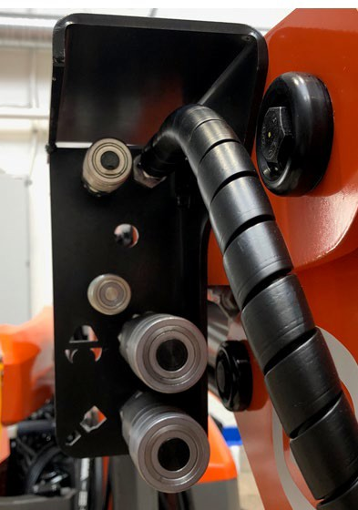
DXR 305 – New unique breaker return line
New bulkhead plate with laser cut tool symbols for ease of use

Slide 12
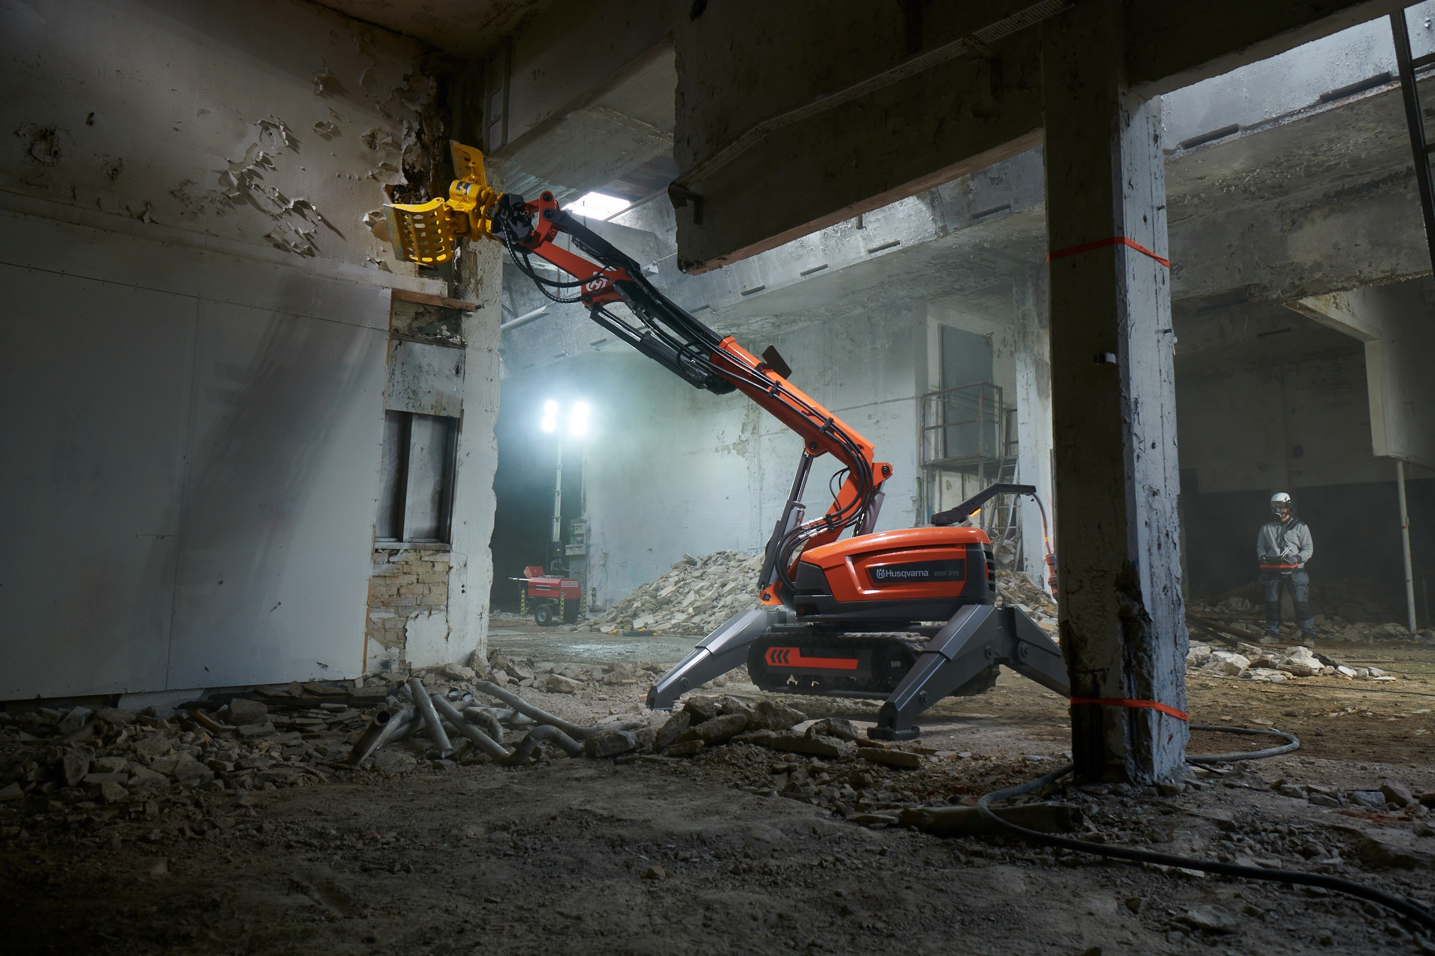
DXR 315 in short
DXR 315 is developed for the customer in need of a Demolition Robot in the
2-ton segment with high performance and long reach utilizing a high precision telescopic arm.
Performance is increased over its predecessor, and it now provides 85 lpm of hydraulic power. The new control system and remote control provides a new level of control and user experience.

Slide 13
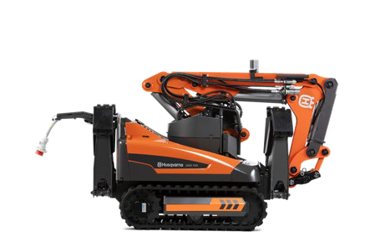
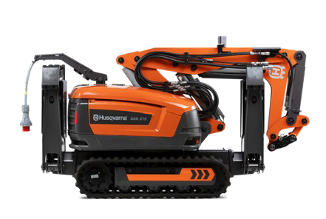
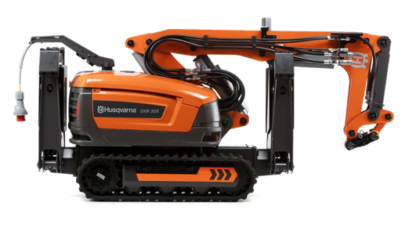
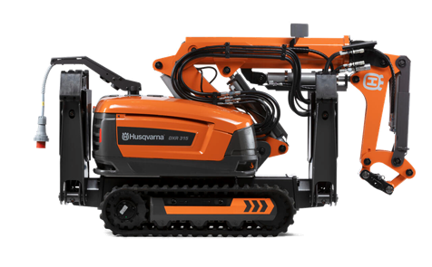
Key Facts – What's New?
Modell | Description | Unique selling feature(s): | Increased electrical performance | Increased hydraulic performance
DXR 145 | Successor of DXR 140 | Third party compliant Functional safety Machine safety EMC New remote control New control system New electrical system Intelligent overload protection Class leading performance | 18.5kW (15kW) | -
DXR 275 | Successor of DXR 270 |  | 24kW (18.5kW) | 75 l/min (65l/min)
DXR 305 | Successor of DXR 300 |  | 27kW (22kW) | 85 l/min (75l/min)
DXR 315 | Successor of DXR 310
Notes:
Presenter
2021-09-01 08:38:37
--------------------------------------------

Slide 14
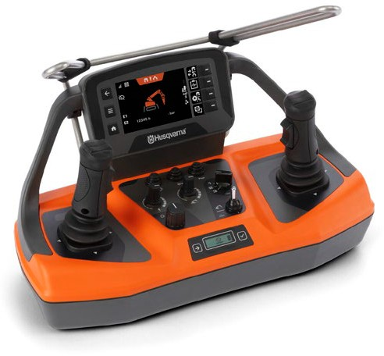
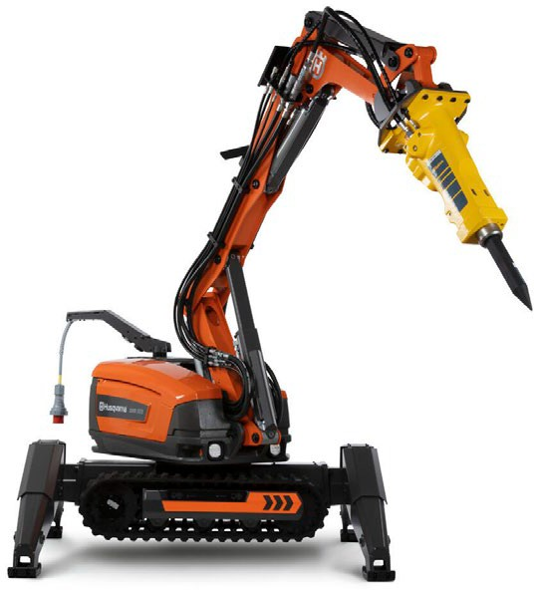
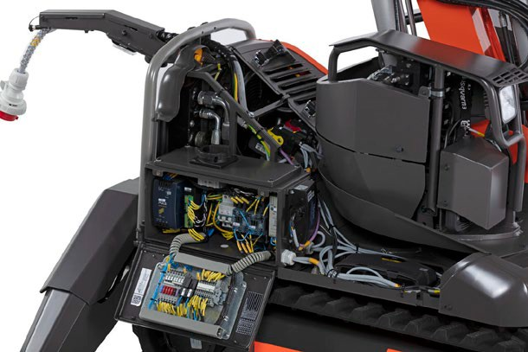
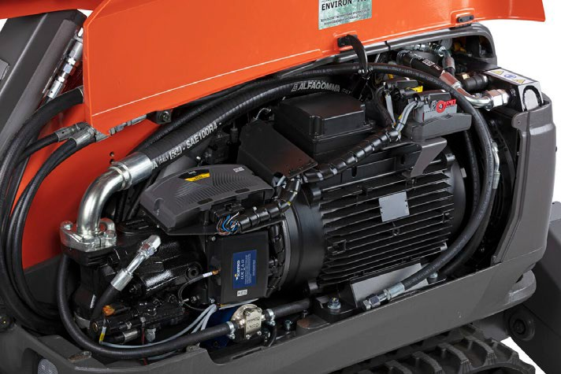
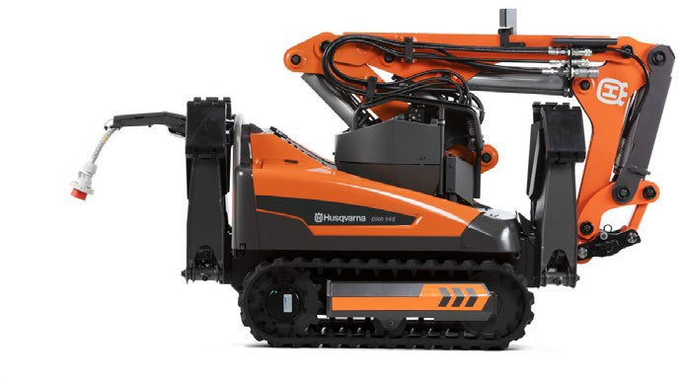
Technical features
New control
system
Increased performance
More Control
Control system provides operator with optimal safety and control for a smooth & precise driving experience.
More Power
Massive power for improved productivity
Safer operation
The all-new Control system enables third party certification for Safety, EMC and Functional Safety.
Extremely durable
Well proven study structural design
Intelligent overload protection Machine performance is maximized and will allow operators to keep working also in hot environments with optimized performance.
Ready for connectivity
Future proofed prepared for connectivity module. For communication with the Husqvarna Fleet Services™ system in your smartphone or Laptop.
All-new Remote Control
Smart fan control for increased
efficiency and lower noise
Updated graphics

Slide 15
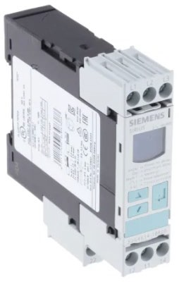
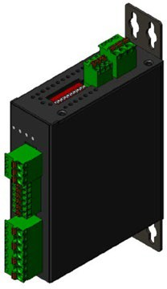
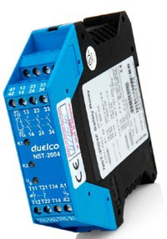
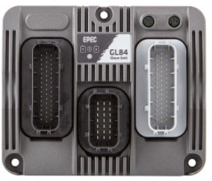
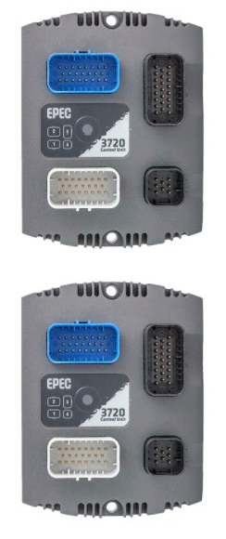
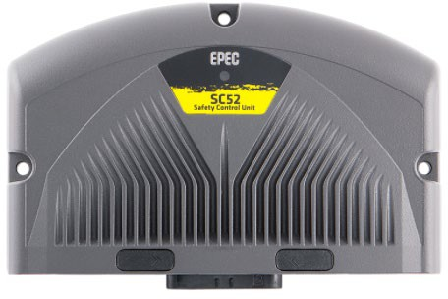
New Control/electrical system
Old
New
Phase sequence relay
Power meter:
CAN-based
Safety relay
EPEC GL84 – Slave
(Tower)
EPEC 3720 – Salve
EPEC GL84 – Slave
(Body)
EPEC SC52 – Master
(Safety Controller)
EPEC 3720 – Master

Slide 16
New Control/electrical system – benefits
Power meter
Reads Power (V) & current (A)
Live values presented in R/C “Machine status”
Automatic phase sequence relay
New electrical system, controller modules
& software
Improved robustness
Improved error detection & handling (Error, Warning, Caution, & Advisory).
Service reminder message
Prepared for connectivity

Slide 17
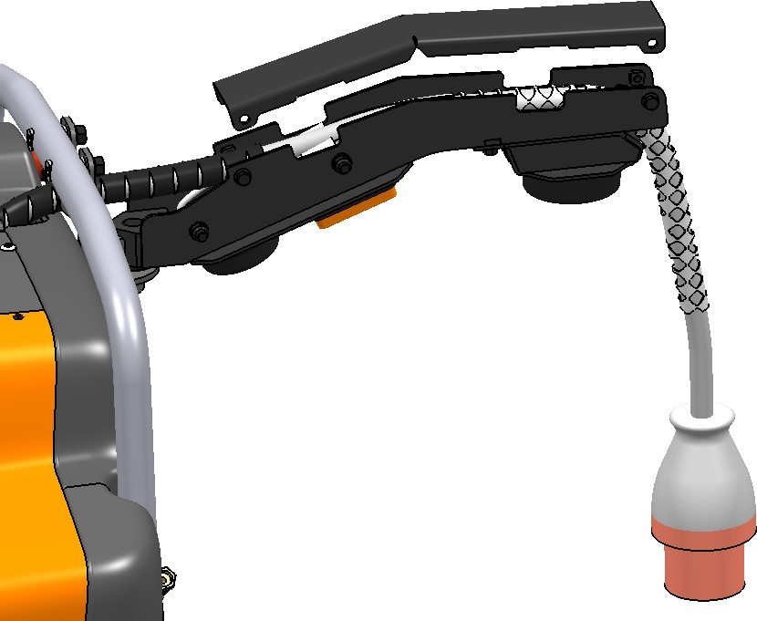
Other updates NEW cable arm – DXR 145
New lid – improved protection, easy service & repair
Prepared for connectivity
(separate antenna, not included at sales start)
New indicator light

Slide 18
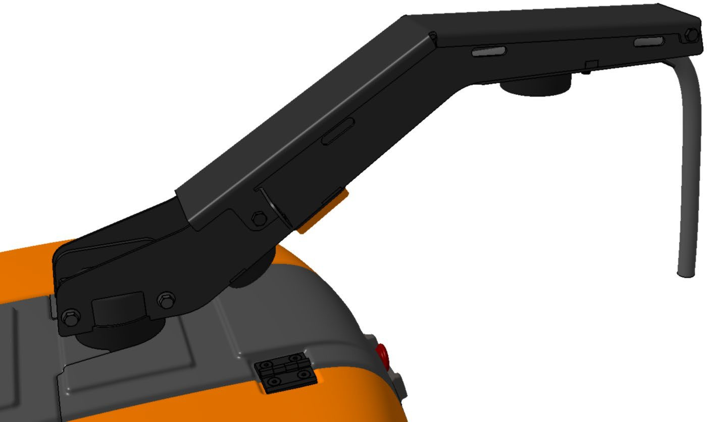
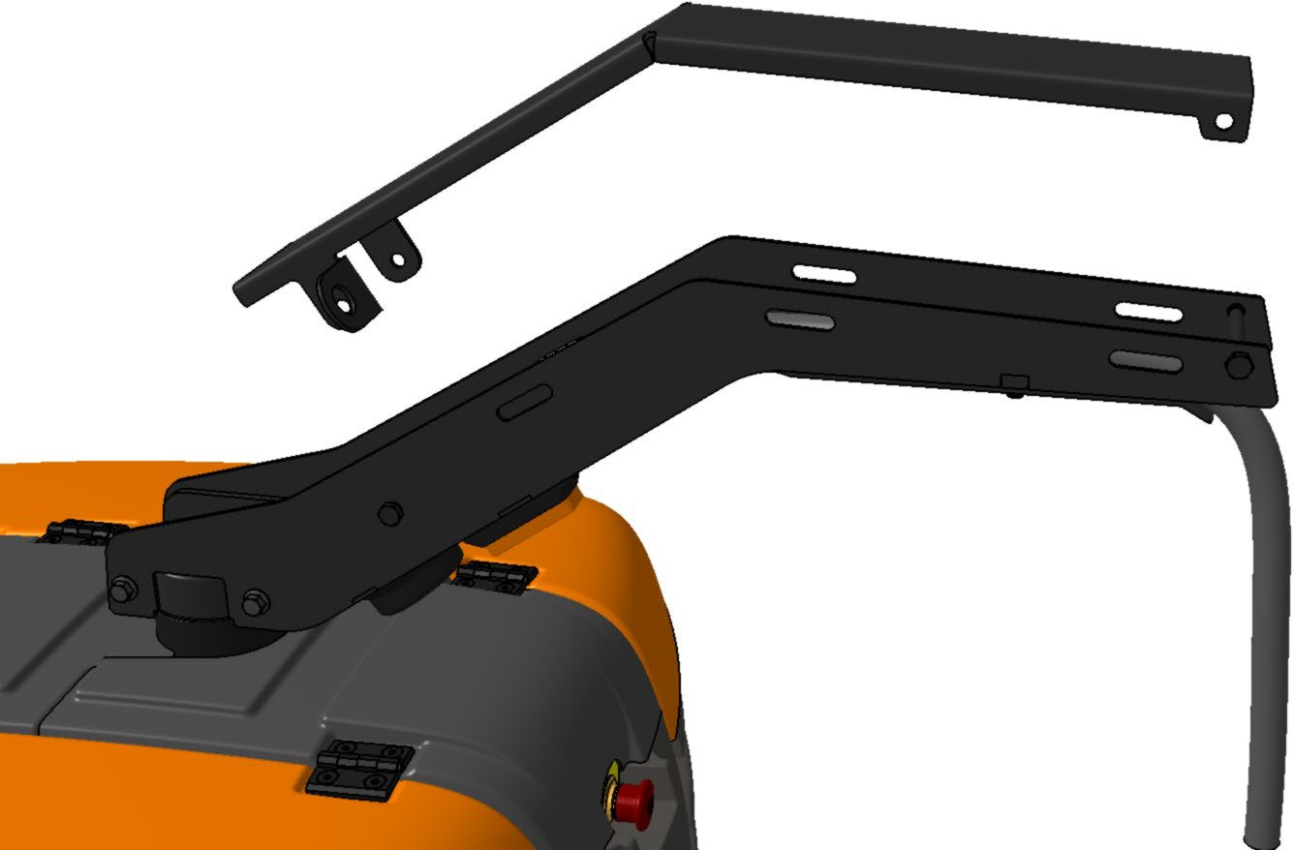
Other updates NEW cable arm – DXR275|305|315
New lid – improved protection, easy service & repair
Attached to bearing with screws for easy service & repair
Prepared for connectivity
(separate antenna, not included at sales start)
New indicator light

Slide 19
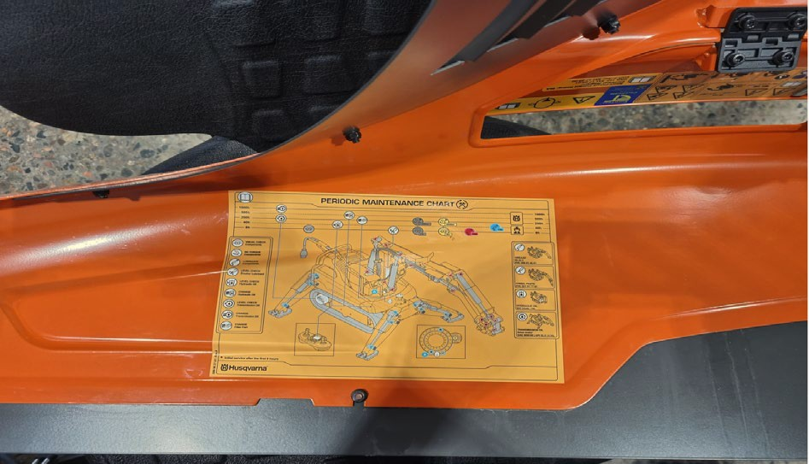
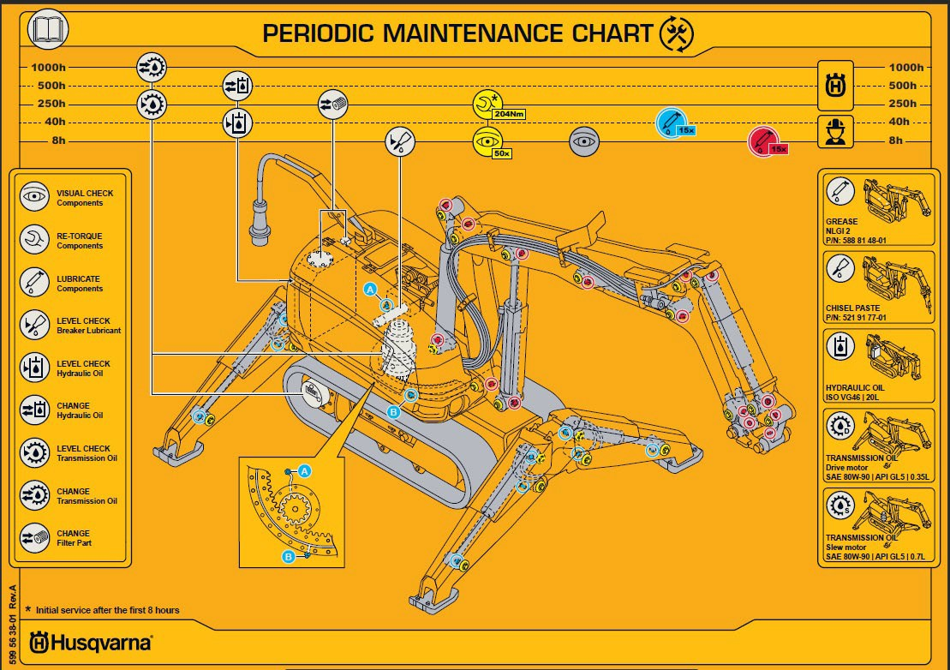
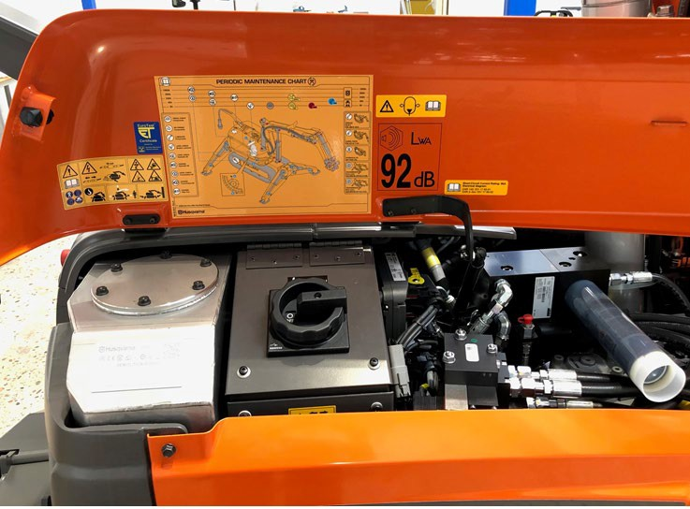
Other updates
Maintenance decal added on machine

Slide 20
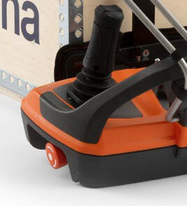
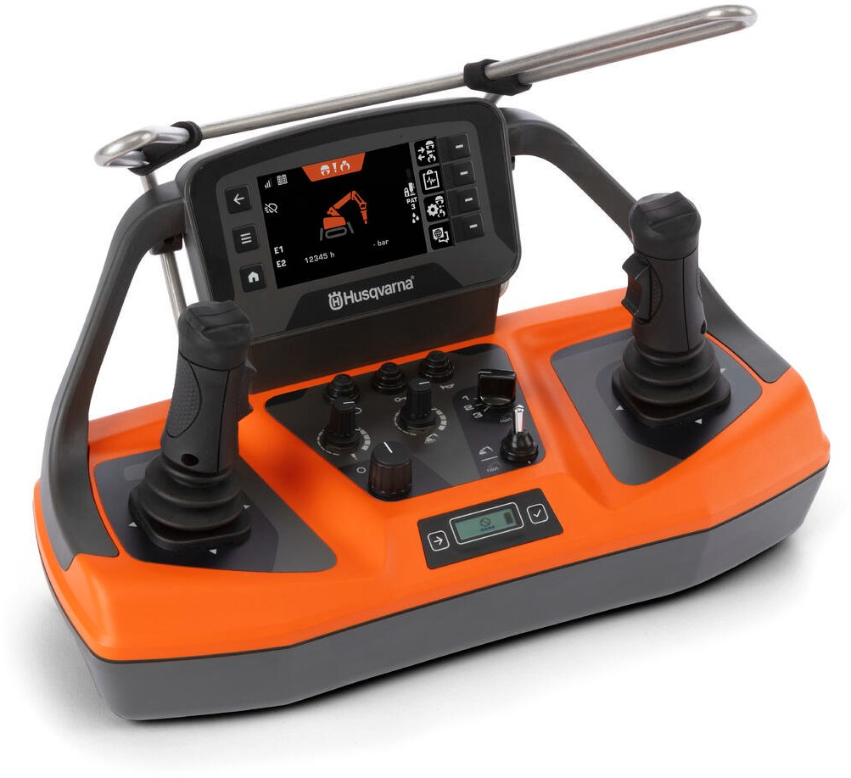
New Remote Control – Features
NEW unique HMI
User friendly
High-End LCD Screen
*34% larger │Improved & Auto brightness
Protective frame, joysticks
Optimized view angle
Machine stop
Frequency hopping 2.4 GHz Radio-link with up to 300 m range
Quick-switch
Work / transport
Dual battery slot
(min 24hrs of runtime)
Thumb Switch
*Compared to old remote

Slide 21
New Remote Control – Features
Area | Feature | Advantage | Value / Gain
Language | Additional languages added: Hungarian, Turkish, Korean, Bulgarian & Romanian. | Easy to use | High efficiency
LCD Screen | Enlarged – 34%
 | Optimized view angle
 | Improved brightness | Less sensitive to sunlight | Less strain on eyes
 | Auto brightness | Adapts to the surrounding
HMI / UX | New menu structure | Easy to navigate & adjust | High efficiency
Lock Screen | Separate button + PIN code | Limited to approved personnel | Improved safety
Work Mode Switch | Separate switch | Possible to switch between work & transport while holding the joystick | High efficiency
Battery | Dual battery slot | Reduced time to swap battery
Plastic casing | Heavy duty design & material | Robust / High durability | Long service life
Bumper frame | Fall protection | Well protected joysticks
Sealing | IP65 | High tolerance of water, moisture & dust

Slide 22
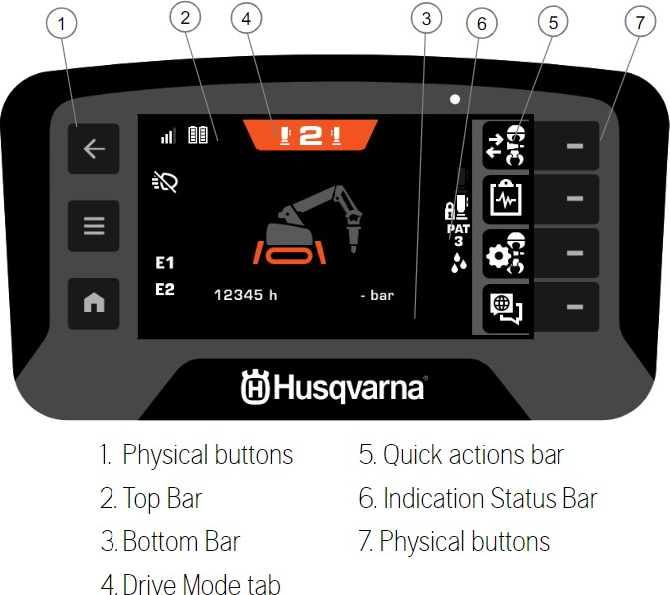
Remote Control - HMI

Slide 23
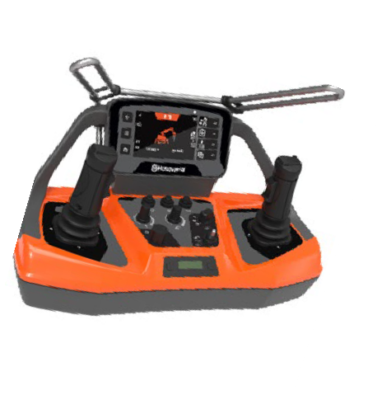
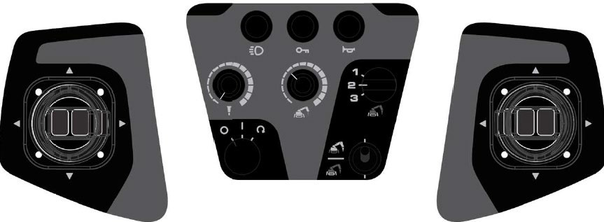
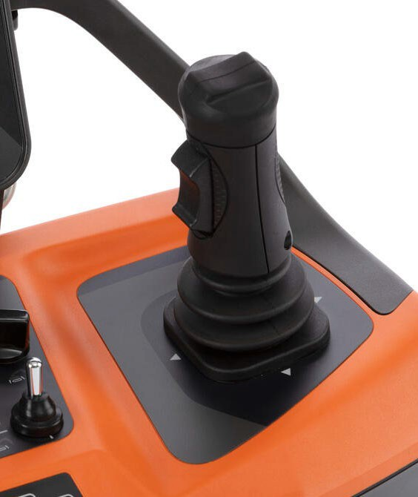
Remote Control – Layout of controls
Lock remote
Pin Code
Work light
Transport Mode
One Hand │Two Hand│Crawl
Potentiometer
Tool │Machine speed
Horn
Machine ON/Off Switch
Work Mode switch
Work │Transport
Unique joystick with thumb Switch

Slide 24
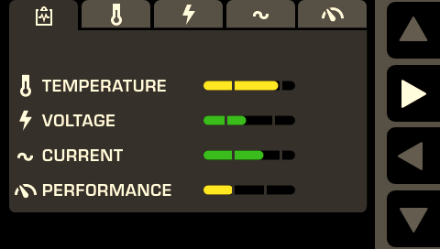
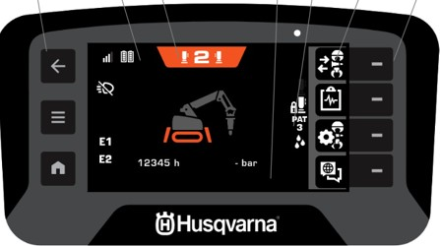
Remote Control – Machine status

Slide 25
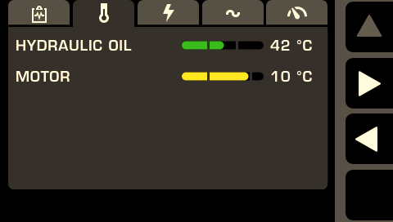
Remote Control – Machine status
Temperature
Voltage
Voltage cont.
Current
Performance

Slide 26
Remote Control – Pattern test
Interactive test mode, shows how the product will operate when you use the joysticks on the remote control.

Slide 27
Remote control accessories
Remote control communication cable
New style plug – molded
Battery (x2)
7.2v Li-ion 5100mAh
NEW robust battery charging station
AC / DC Adapter inc. wall socket plugs (EU, UK, US, China, Australia)
12/24VDC adapter (not in pic.)

Slide 28
New Harness – Features & changes
New cc distance between pins
I.e., harness is not backwards compatible
New button to change position – push to release and change angle (old solution = push )
Improved lock mechanism
One additional tilt position added (center), 4 in total between 0-39°

Slide 29
R/C battery – ”Transportation mode”
If the batteries do not operate for 5 days, the display for state of charge is red, they are in transportation mode to save energy, extend the battery service life and to ensure safe shipment and the remote control cannot start to operate.
Before use, the batteries must be connected to a charger for a short period (5-10 sec.).

Slide 30
Remote Control - Technical data
Battery specification | 7.2V Li-ion, 5100 mAh
Battery | 2 x Li-ion batteries supplied with the product
Operation time, h | 12
Charge time, h | 3
Signal transmission | Radio signal transmission or cable.
Radio frequency bands | 2.4 GHz
Max. radio frequency power transmitted, dBm | 20
Dimensions, mm/in. | 400x216x291/15.7x8.5x11.5
Weight, kg/lb | 3.25/7.2
Protection class | IP65
Operating temperature | -20–60°C /-4–140°F
Storage temperature with battery, °C/°F | Less than 1 month: -20–50°C / 4–122°F Less than 3 month: -20–40°C / 4–104°F Less than 1 year: -20–20°C / 4–68°F
Storage temperature without battery, °C/°F | -40–80°C / -40–176°F
Charging temperature, °C/°F | 10–45°C /50–113°F

Slide 31
DXR - Technical data
 |  | DXR 145 | DXR 275 | DXR 305 | DXR 315
General | Rotation speed, rpm | 6
 | Max. transport speed, km/h / mph | 3/1.9
 | Max. slope angle, degrees | 30 | 25
Hydraulic system | Volume hydraulic system, l/gal | 40/10 | 50/13
 | Pump type | Load sensing axial piston with variable displacement.
 | Max. pump flow2, l/min or gal/min | 0-52 or 0-14 | 0-75 or 0-20 | 0-85 or 0-22,5
 | Standard pressure, bar | 200
 | Increased main pressure, bar | 250
 | Pressure for caterpillar tracks tension and outriggers retracted, | 130 | 200
 | Hydraulic breaker pressure, bar | 160 | 150 | 160
Motor | Motor power, kW/hp | 18.5 (50 Hz) │18.5 (60 Hz) | 24 (50 Hz)│24 (60 Hz) | 27 (50 Hz)│27 (60 Hz)
 | Speed, rpm | 2885 (50 Hz) │ 3500 (60 Hz) | 1470 (50 Hz) │ 1775 (60 Hz)
 | Rated voltage, V | 380–420 (50Hz)│440–480 (60Hz)
 | Rated current, A | 32 (50 Hz)│30 (60 Hz) | 46 (50 Hz)│39 (60 Hz) | 52 (50 Hz) │ 44 (60 Hz)
Weight | Product weight without tool, kg/lbs | 985/2172 | 1750/3858 | 1960/4320 | 2020/4453
 | Max. recommended tool weight, kg/lbs | 200/441 | 310/683

Slide 32
Attachments
No changes made to current attchment offering, current P/N applies
No need to change any configuration in the new machines nor in the tools when moving a tool between an old and a new machine

Slide 33
www.husqvarnagroup.com www.diamant-boart.com

